Slide 1

JCAPS 5.1 HTTPServer
Phani Krishna

Slide 2
HTTPServer Scenario
Components Required
  Connectivity Map
  Java Collaboration
  Deployment Profile
  External System

Slide 3
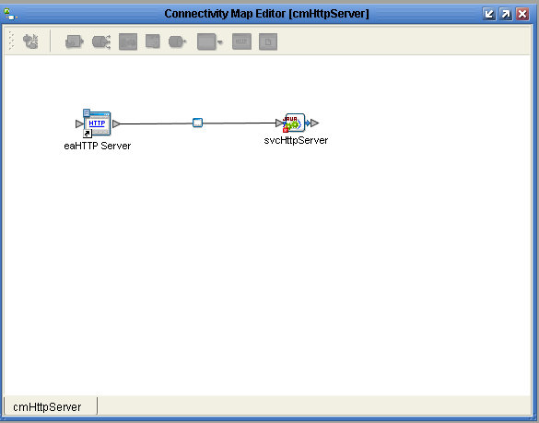
Connectivity Map

Slide 4
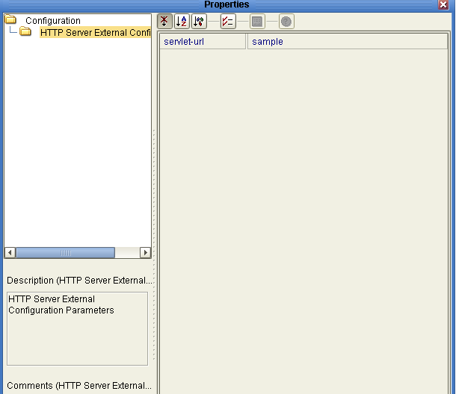
HTTP Configuration Properties
( eaHTTPServer -> svcHTTPServer)

Slide 5
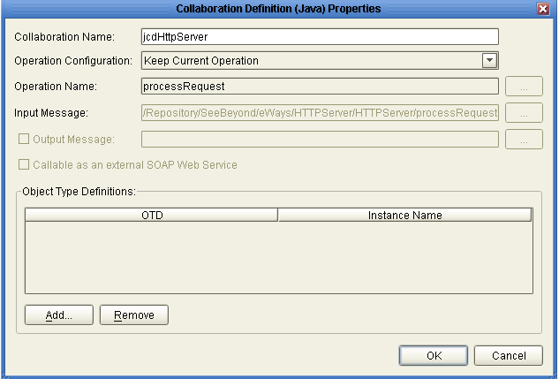
Java Collaboration
(svcHTTPServer)

Slide 6
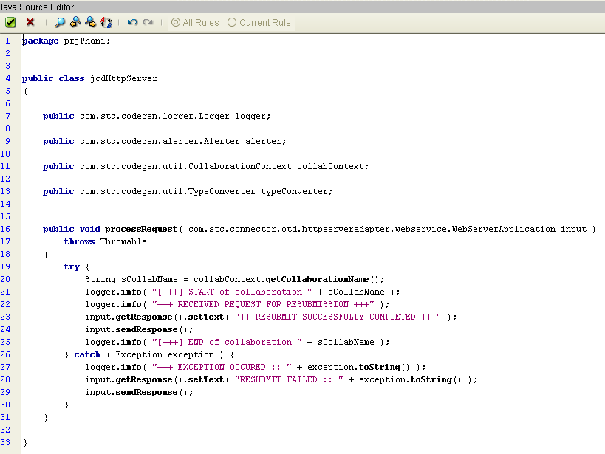
Jcd Code
(svcHTTPServer)

Slide 7
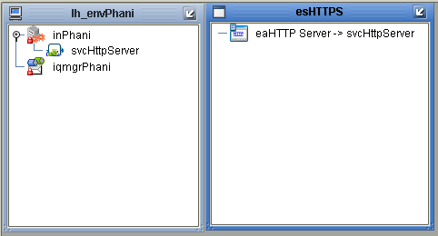
Deployment Profile
(dpHTTPServer)

Slide 8
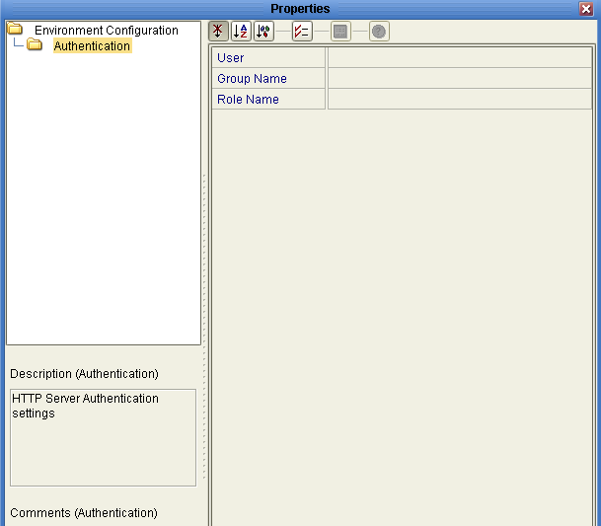
External System - esHTTPServer

Slide 9
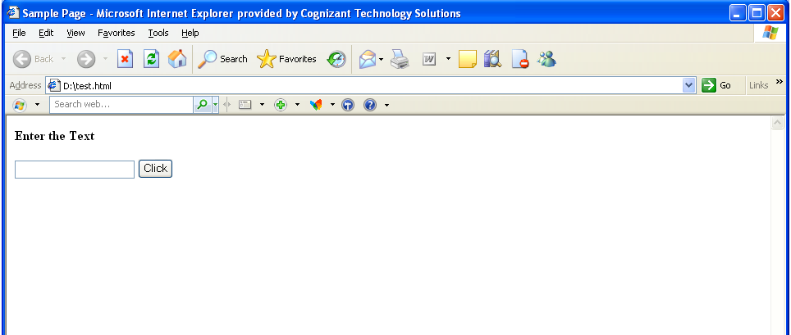
Sample Client Page

Slide 10
Client Page Source
<html>
<title>Sample Page</title>
<body>
<form name=Sample method=post action=http://localhost:18001/dpHttpServer_servlet_sample/sample>
<h4>Enter the Text<h4><input type=textbox length=20>
<input type=submit name="submit" value="Click">
</form>
</body>
</html>

Slide 11
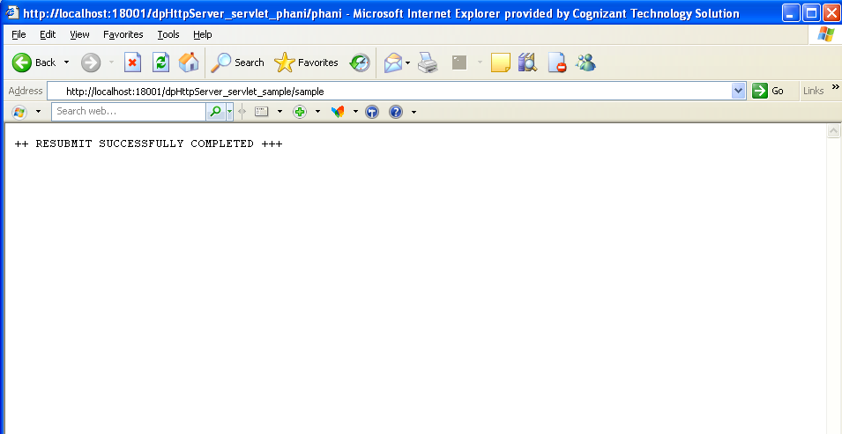
Output Page

Slide 12
Thank You
Phani Krishna

